Slide 1

Loan Approval Prediction: Best ML Model Comparison

Slide 2

Project Objective
To build the ML model which will make accurate predictions and will help Mumbai Trust Bank to streamline loan approval
Mumbai Trust Bank

Slide 3

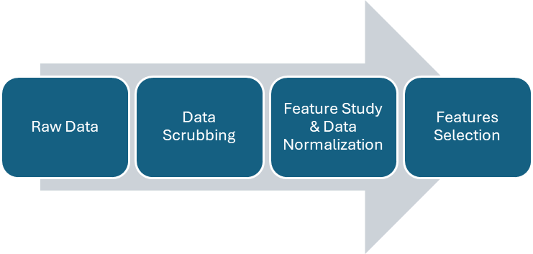





METHODOLOGY
Model
Logistic Regression
K-Nearest Neighbours (KNN)
Support Vector Machine (SVM)
Random Forest
XGBoost
Decision Tree
Model Comparison
Testing Data
Training Data
Model Selection

Slide 4
DATA SCRUBBING
4.5k records (individual loan decisions)
12 features, e.g. annual income, assets value, cibil score (credit score), loan amount, loan terms, etc.
Rectified some data formatting issues
Prepared data frame for further analysis

Slide 5
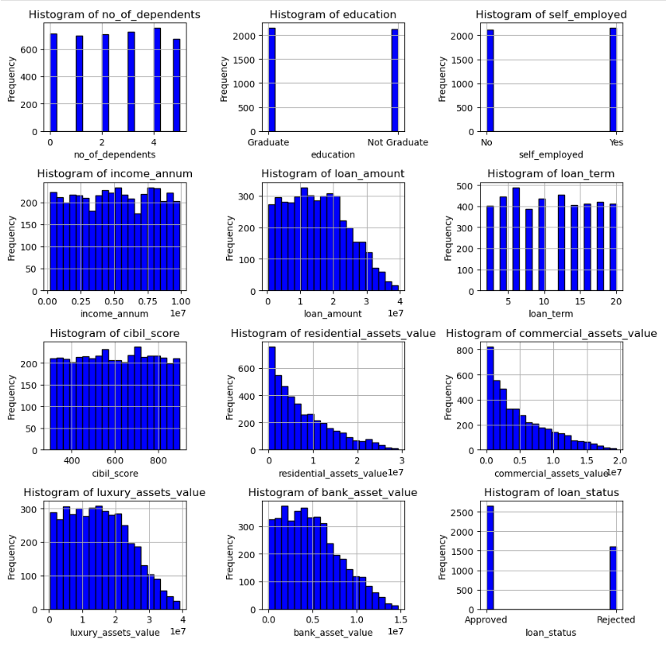
FEATURE STUDY & DATA NORMALIZATION
Numerical and Categorical Features
Category Split (education, employment, loan status)
Outliers

Slide 6
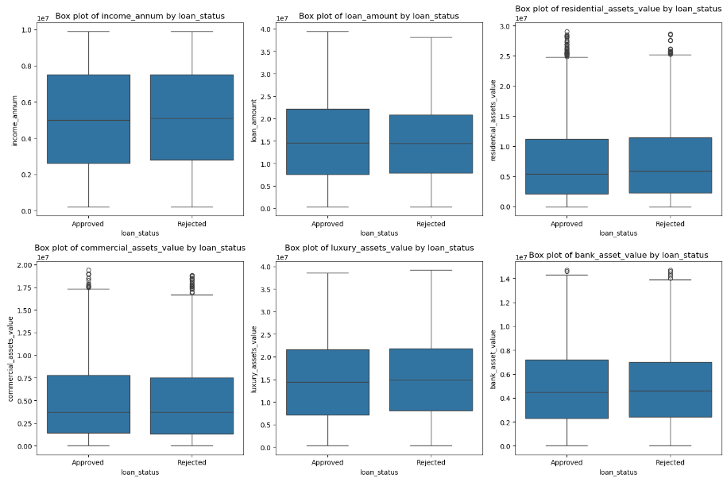
FEATURE STUDY & DATA NORMALIZATION

Slide 7
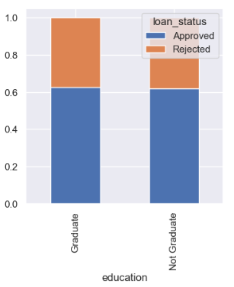
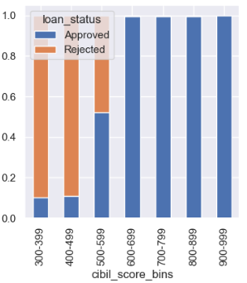
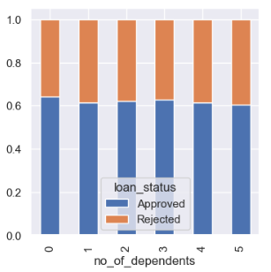
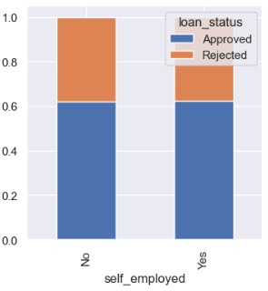
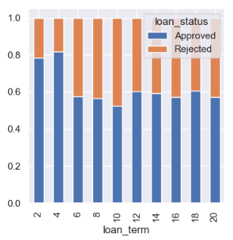
FEATURE STUDY & DATA NORMALIZATION

Slide 8
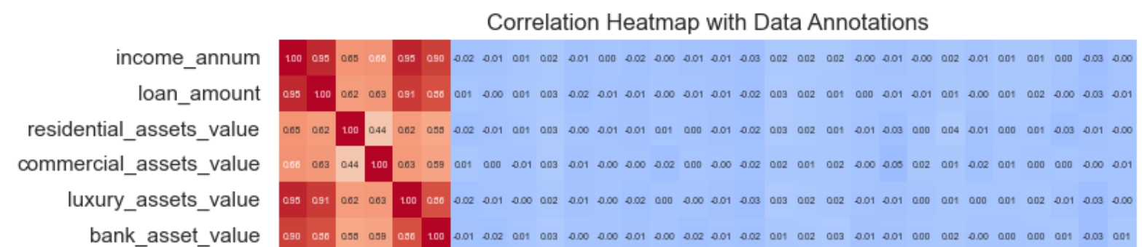
FEATURE STUDY & DATA NORMALIZATION

Slide 9
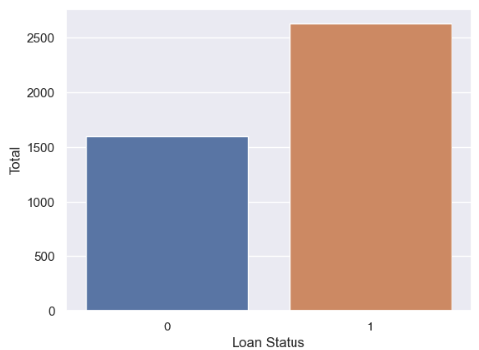
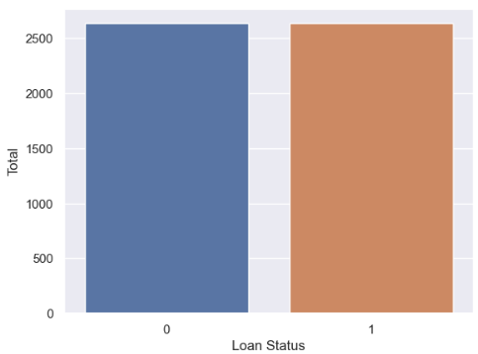
FEATURE STUDY & DATA NORMALIZATION
Synthetic Minority Over-sampling
Before SMOT
After SMOT

Slide 10
Models
Logistic Regression
K-Nearest Neighbours (KNN)
Support Vector Machine (SVM)
Random Forest
XGBoost
Decision Tree

Slide 11
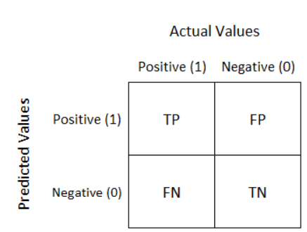
CONFUSION MATRIX
TP = True Positive: the model correctly predicts that a loan will be approved
FP = False Positive: known as a Type I error. The model incorrectly predicts that a loan will be approved, but actually, the loan is rejected
TN = True Negative: the model correctly predicts that a loan will be rejected, and indeed the loan is rejected.
FN = False Negative: known as a Type II error. The model incorrectly predicts that a loan will be rejected, but actually, the loan should have been approved

Slide 12
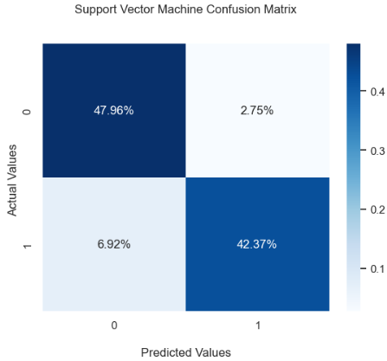
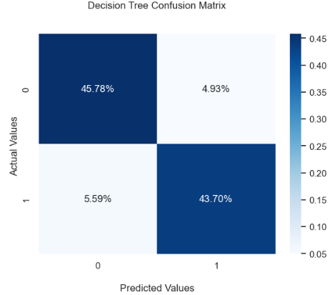
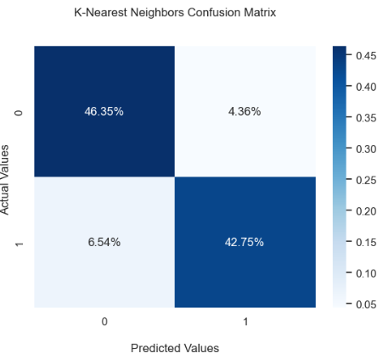
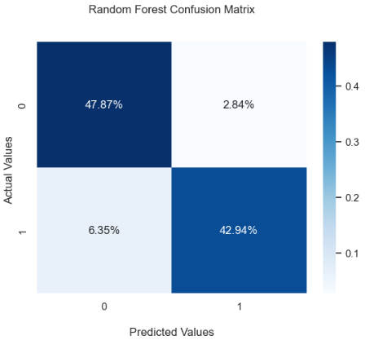
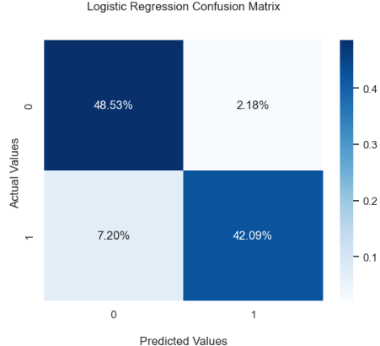


Slide 13




USEFUL METRIX
ACCURACY - Out of all the predictions we made, how many were true?
PRECISION - Out of all the positive predictions we made, how many were true?
RECALL - Out of all the data points that should be predicted as true, how many did we correctly predict as true?
F1 SCORE - F1 can therefore be used to measure how effectively our models make that trade-off

Slide 14
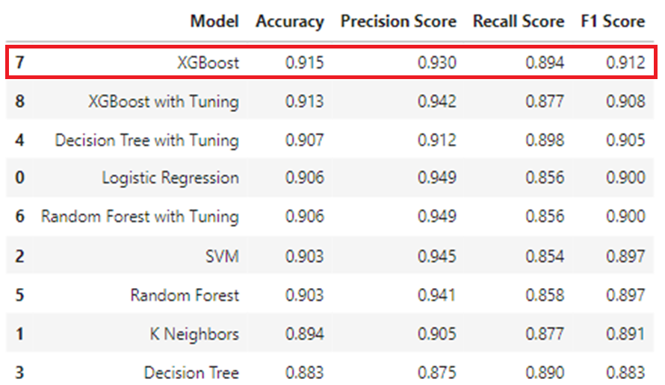

MODEL COMPARISON

Slide 15
THANK YOU!
Email: grigorenko.jane@gmail.com
GitHub: https://github.com/JaneGrig
LinkedIn: linkedin.com/in/evgeniya-jane-grigorenko-47692211b

